Slide 1
let’s make club events
!
accessible
Notes:
Ask leading questions (how many people here are in clubs? etc)

Slide 2
the problem(s)

Slide 3
Manny
Hi!

Slide 4
the pitch
1
2
3
Engage in Dialogue
Work with Students
Create a Platform

Slide 5
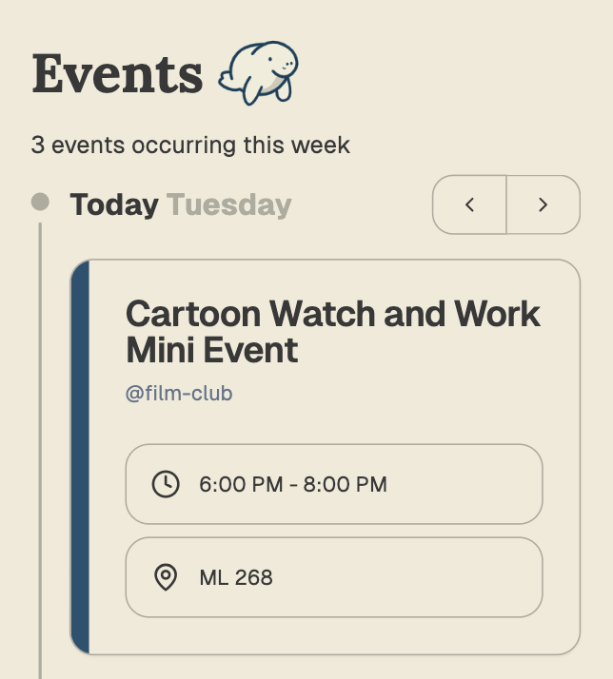
the example
Students want events catered to their interests…
but clubs are run by
busy students :(

Slide 6
the hope
1
2
3
Find Your People
Stay in the Loop
Promote Club Growth

Slide 7
manny help :)

Slide 8
Be it resolved that WUSA commits to exploring options for a centralized digital space for students to publish club events, through consultation directly with student developers.
pls help us

Slide 9
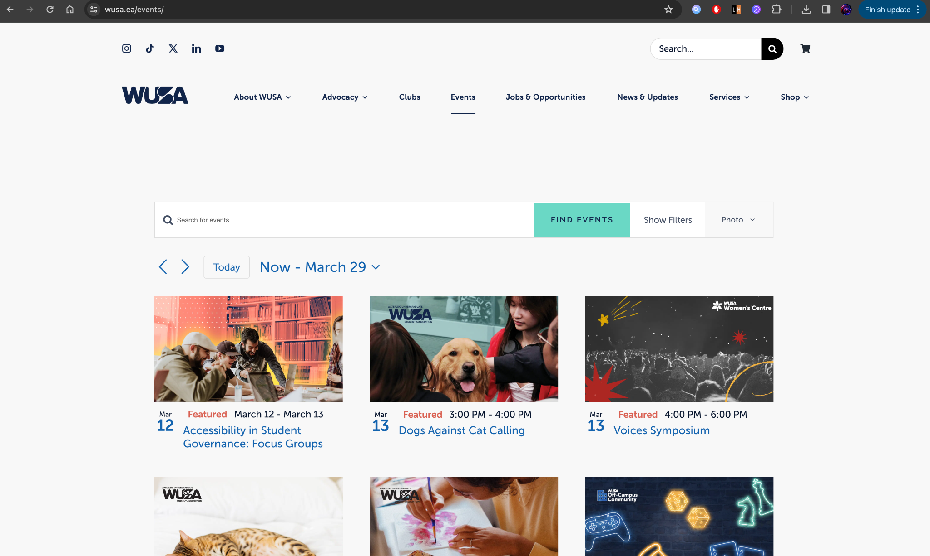
Appendix 1
https://wusa.ca/events/

Slide 10
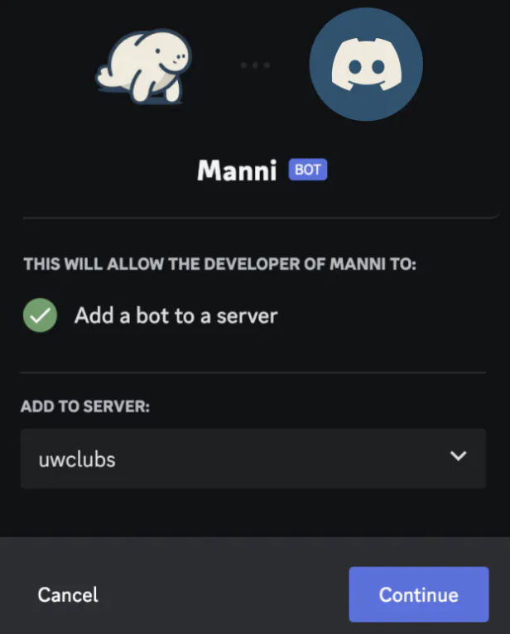
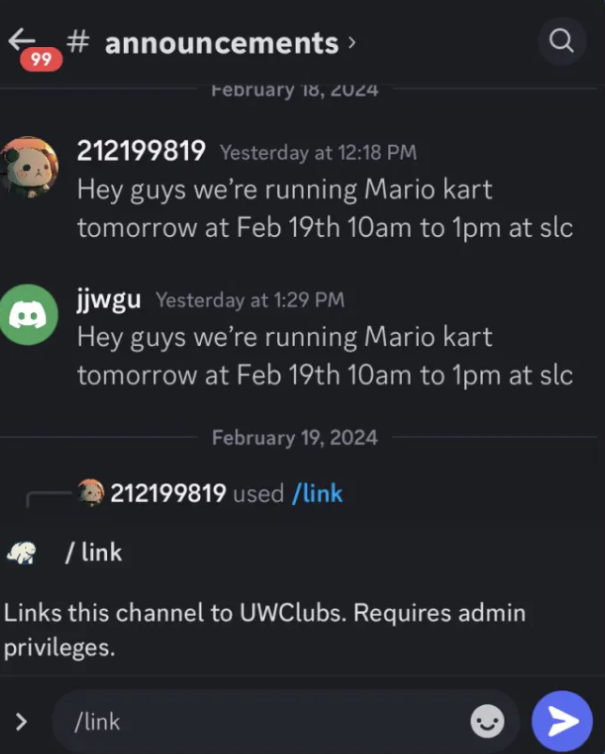
Appendix 2
How UWClubs Works

Slide 11
Appendix 3
1
2
3
Integration
With WUSA Events
Assist with Outreach (Clubs Mailing List)
Engage in Discussion for Further Collaboration
Ways WUSA could help UWClubs

Slide 12
Appendix 4
Week
Month
Club profiles
Edit with Webforms
Internal vs External Events
Predict edit/delete
Semantic Search
Filter and Sort
Future Features Timeline

